Slide 1

pdf scraping for army national guard state and service award identification and eligibility
Syracuse university
IST 652
Valerie M. Jones

Slide 2
Introduction
State and service award identification
Soldiers throughout the Army National Guard are eligible for various State and Service Awards throughout their career.
Eligibility for these awards is determined by their Pay Entry Base Date (PEBD)
This data is located in various Army Information Management Systems
Part time Company Leadership can access this information by reviewing the individual Service Member’s Retirement Points Accounting Management (RPAM) Statement

Slide 3
Business problem
A shrinking fulltime work force
In six months, there has been a 40 percent increase in fulltime Soldier attrition rates within the Battalion
Many of these individuals held critical readiness positions within the Battalion and it has created a major backlog in Soldier Award actions and processing.
Part-time Company leadership have been tasked to assist limited fulltime staff in diminishing the award backlogs.
Army databases storing PEBDs cannot be accessed by part time Company leadership responsible in identifying eligible Soldiers.

Slide 4
Project Scope
Automation
Mitigate the risk of human error and delay for State and Service awards for Army National Guard Soldiers by creating a program that identifies specific service codes and attributing effective dates, moving each to a CSV file. The types of analysis this program would provide:
Generate a by name Roster of SMs and Pay Entry Base Dates.
Calculate eligibility of initial and subsequent State Medals and accoutrements.
Calculate Number of Soldiers eligible for Twenty-Year letters and Medals.
Calculate the number of Soldiers eligible for initial and subsequent Army reserve Component Achievement Ribbons and accoutrements.

Slide 5
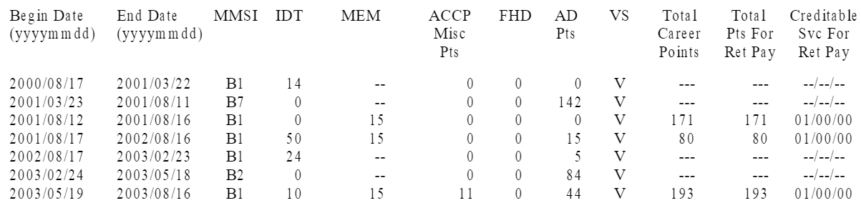
Concept
Extract of RPAM Statement
Isolate the codes in Rpam
Create program to scrape RPAM PDF file to identify certain codes of Soldiers that indicate when they joined the National Guard (B1 codes).
Scrape the SM name, last four of SSN and corresponding ‘Begin Date’ of the B1 code and move to CSV File
Create columns in CSV file:
Name
Last Four
Begin Date
ARCAM Eligibility
ARCAM Number
State Medal Eligibility
State Medal Number

Slide 6
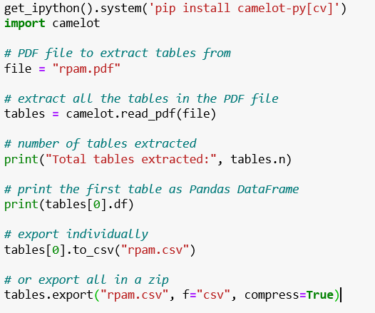
Python Code
#Medium.com, stackoverflow, W3W School

Slide 7
Calculations
Who’s Eligible and for what?
SMs can receive more than one award as their time in service increases.
After creating the CSV file, the eligibility and award number fields would need to be calculated to populate the data within the columns.
Eligibility would be a Boolean Expression after years between ‘Begin date’ and Current date are calculated
The number of awards would be calculated from the PEBD Date based on the regulatory criterion for award
I.e. Certain State Awards are given every three years of good service.

Slide 8
Conclusion
Work in progress
Unfortunately I could not get the code to read the file correctly as there were several issues with how I configured my computer. Python does not work well with spaces in naming conventions. Much of this project was spent reconfiguring my administrator user folder.
The next issue was getting the PDF to scrape the text properly. Since the data was not in a true table, the code would not tie the B1 code to the correct Begin date and therefore I could not calculate eligibility.
The header information of the RPAM statement was required to create a user ID which could not be found even by converting the PDF to a CSV.
I am going to continue to work through this project as I feel it will be a good portfolio piece and a useful tool for company leadership.

